Slide 1
Minor Project | Abstract Seminar
Department of
Computer Science & Engineering

Slide 2
Mini Project
“Eye Detection On A Human Face”
Internal Guide
Name :Dr.Shaik Masood Ahamed
Designation : Professor
Project Members (batch no:A9)
Roll NO :18D91A05B0
Name : Abdullah Mazaruddin Khaja
Roll NO : 18D91A0574
Name : Mohammed Obaidullah
Roll NO : 18D91A0575
Name : Omer Bin Essa Billesharam

Slide 3
Mini Project | Index
Content
1.Introduction
2.Objective/Purpose
3.Existing System
4.Drawbacks Of Existing System
5.Proposed System
6.Advantages of proposed system
7.Scope of the system
8.Hardware and Software Requirements

Slide 4
.
Mini Project
Introduction
. Automatic tracking of eyes with its application in biometric, security, intelligent human-computer interfaces, and driver’s drowsiness detection system
. In eye localization methods have been classified into four main categories .
-> Shape-based (Approaches which described by its shape)
-> Feature-Based (Shape Methods which explore the characteristics of the human eye to identify a set of distinctive features around the eyes)
-> Appearance Based Methods ( which detect and track eyes directly)
-> Hybrid Models (which aim at combining the advantages of different eye-models within a single system to overcome their respective shortcomings)

Slide 5
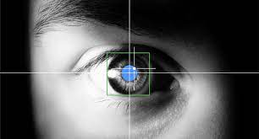
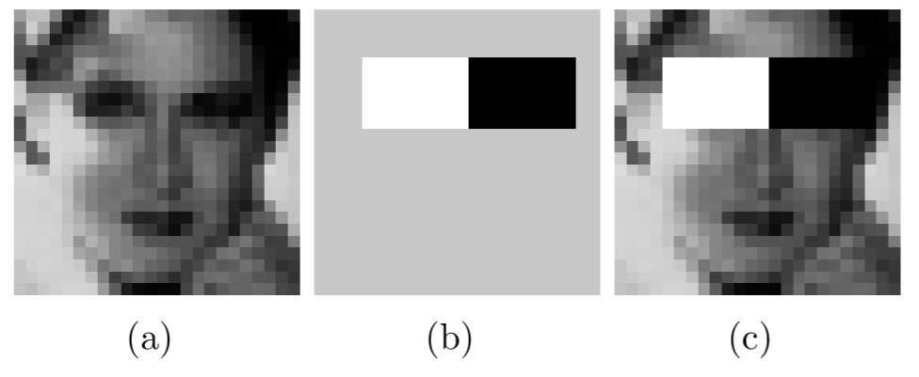
Mini Project
Eye detection

Slide 6
Mini Project
Objective/Purpose
Eye tracking is a sensor technology that makes it possible for a computer or other device to know where a person is looking
An eye tracker can detect the presence, attention and focus of the user.
The ability to control a computer using the eyes is also vital for people who are unable to speak or use their hands.
It provides maximum security

Slide 7
Mini Project | Existing System
Current most of the objection detection model just detect the region of the eye using Haar cascade detector which use filters to detect

Slide 8
Mini Project | Drawbacks Of Existing System
Most of the software are not able to detect the eye if the user is wearing glasses
It detects the region with bounding box which contains the eye but not the eye curve, pinpoint of the eye
However changes in the face pose illumination variation and eye occlusions make it default to detect eyes

Slide 9
Mini Project | Proposed System
For the problems araised in the existing system mentioned above,
We have come with our proposed system for detecting eye from the human face to give prominent results in the eye detection models .
We are using features extraction and feature recognition to recognize the region which contains the eye then advance image processing techniques to get the boundary of the eye which are used in all modern face recognition model

Slide 10
Mini Project
.
Advantages of proposed system
It uses most advance features extraction techniques used by all modern face recognition projects by companies like google, apple. It gives us the exact eye instead of a box containing the eye.

Slide 11
Mini Project
Scope of the system
We can extend this project for further security enhancements by improving the detection of iris .
We can store the scanned data and can use in future for identity purposes
This also have scope in army and crime control system

Slide 12
Mini Project | Software and Hardware Requirements
Technology
Software Requirement Specification
Front End : HTML, JAVASCRIPT
Back End : PYTHON
Operating System : Windows-10
Frame Work : PYCHARM
Hardware Requirements
Processor : Intel Pentium
Hard disk : Minimum 500MB
RAM : Minimum 2GB

